Slide 1
Coca-Cola Stock Analysis
A Comprehensive Analysis of Coca-Cola’s Stock Performance Using Data Analytics, Machine Learning, and Financial Insights
-Sonali Pawar

Slide 2
Project Objective
The objective of this project is to perform a comprehensive analysis of Coca-Cola’s stock performance by integrating data analytics, machine learning, and financial analysis. The goal is to clean and prepare historical stock data, engineer useful technical indicators, visualize key market trends, and build a predictive model to forecast future prices.
Additionally, the project aims to implement a live prediction system using real-time data and evaluate Coca-Cola’s financial health using fundamental metrics, providing a holistic view of the company’s performance.
Analyze Coca-Cola’s stock performance using historical market data.
Visualize stock trends and patterns through various statistical and graphical techniques.
Conduct Financial Analysis to evaluate Coca-Cola’s profitability, margins, and overall financial health.

Slide 3
Data overview
The project uses two datasets — Coca-Cola Stock History and Coca-Cola Stock Info, containing historical price movements and financial indicators of The Coca-Cola Company.
Dataset Highlights
Time Period: 1962 – 2025
Records (Rows): ~15,000
Features (Columns): 6 main attributes (before feature engineering)
Market Source: Yahoo Finance (Ticker: KO)
Stock Range: Price between $0.03 – $65
Coca-Cola Stock History:
Date — Trading date
Open — Opening stock price
High — Highest price of the day
Low — Lowest price of the day
Coca-Cola Stock Info:
Description — Name of financial metric (e.g., P/E Ratio, Profit Margin, Revenue Growth)
Information — Corresponding numeric or textual value

Slide 4
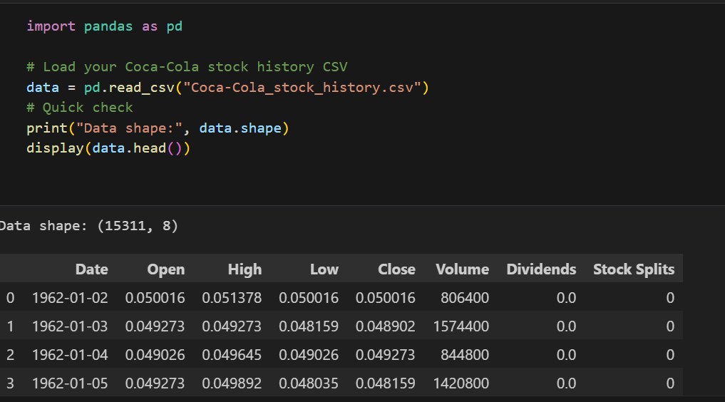
“I started by loading Coca-Cola’s historical stock data using the Pandas library.
The dataset contains over 15,000 daily records of Open, High, Low, Close, and Volume values, covering more than 60 years of market performance.
We verified the structure of the dataset using data.shape and displayed the first few rows to confirm that the data loaded correctly.”

Slide 5
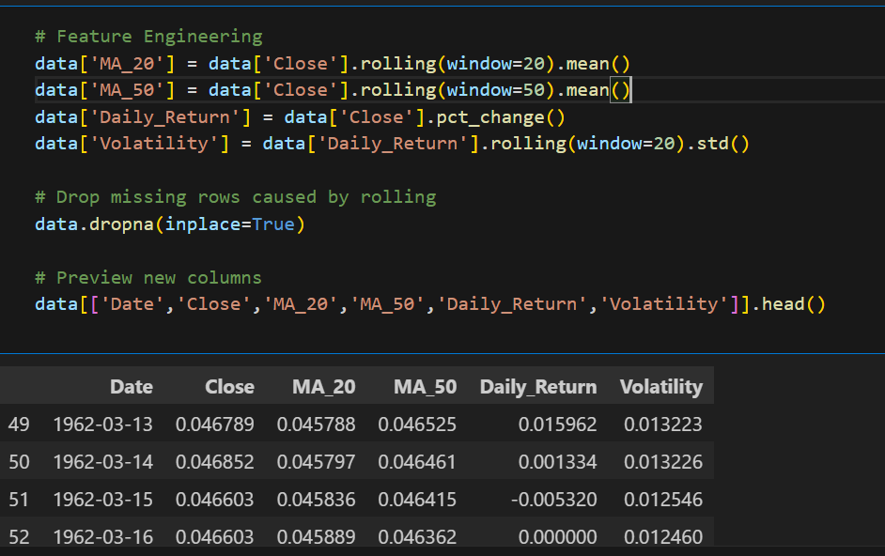
“Feature engineering was performed to create additional variables that better represent stock behavior.
We calculated moving averages (MA_20, MA_50) to capture short- and mid-term trends, daily returns to measure performance, and volatility to assess risk.
These derived features enhance the predictive capability of the model.”

Slide 6
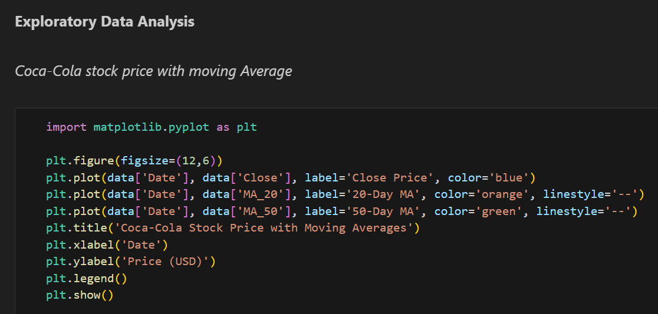
The blue line shows the actual Coca-Cola stock price movement over time.
The orange dashed line (MA_20) shows short-term trends.
The green dashed line (MA_50) shows medium-term trends.
When the MA_20 crosses above MA_50, it’s often considered a bullish signal (price might go up).
When the MA_20 crosses below MA_50, it’s often a bearish signal (price might drop).

Slide 7
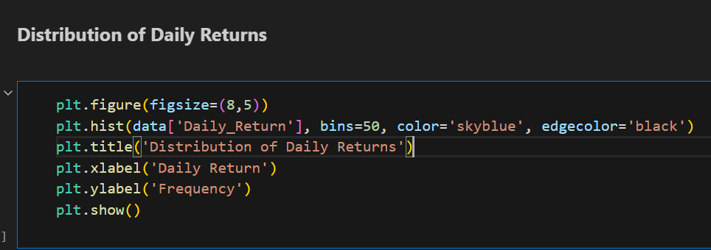
The histogram represents the frequency distribution of daily returns.
The x-axis shows the daily return values (positive and negative %).
The y-axis shows how often those returns occurred.
Most returns are clustered around 0%, meaning Coca-Cola’s stock generally shows low day-to-day volatility.
A few extreme values (tails) represent large price jumps or drops (market shocks)

Slide 8
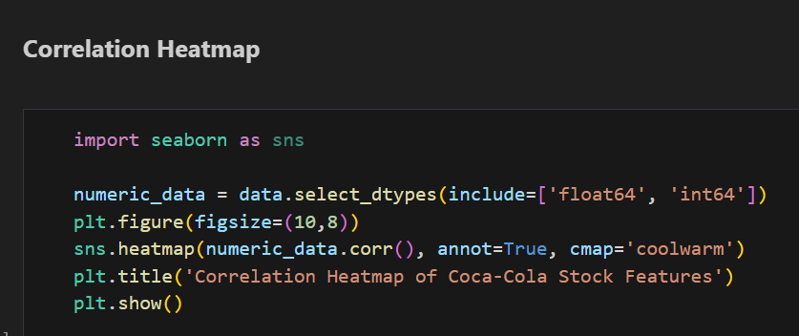
“The correlation heatmap shows how different stock indicators are related to each other”.
The heatmap visually represents how closely related each pair of features is.
Correlation values range from:
+1 → Strong positive relationship
-1 → Strong negative relationship
0 → No relationship

Slide 9
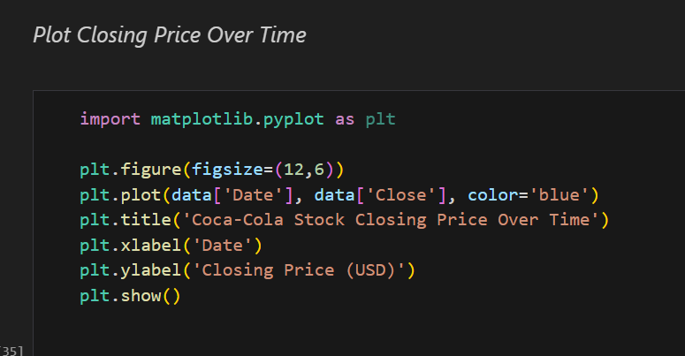
The upward slope of the blue line over decades indicates steady long-term growth in Coca-Cola’s stock value.
You may also notice short-term dips — these correspond to market corrections or global events (e.g., recessions, COVID-19).
The chart highlights how Coca-Cola’s stock has been a stable, growing investment over time

Slide 10
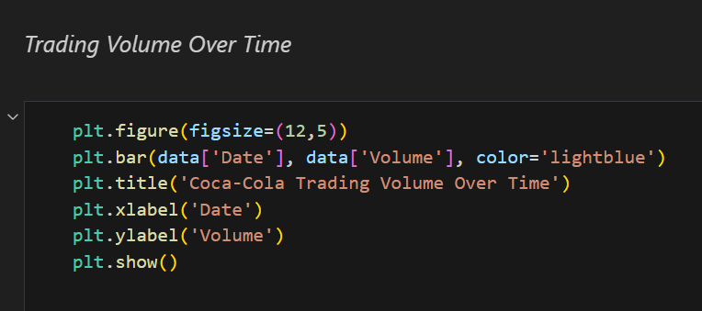
The height of each bar shows how many Coca-Cola shares were traded on that date.
Spikes in volume indicate high investor activity — often during:
  Earnings announcements,
  Product launches,
  Economic events, or
  Market corrections.
Periods of low volume mean fewer trades, suggesting stability or reduced investor interest.

Slide 11
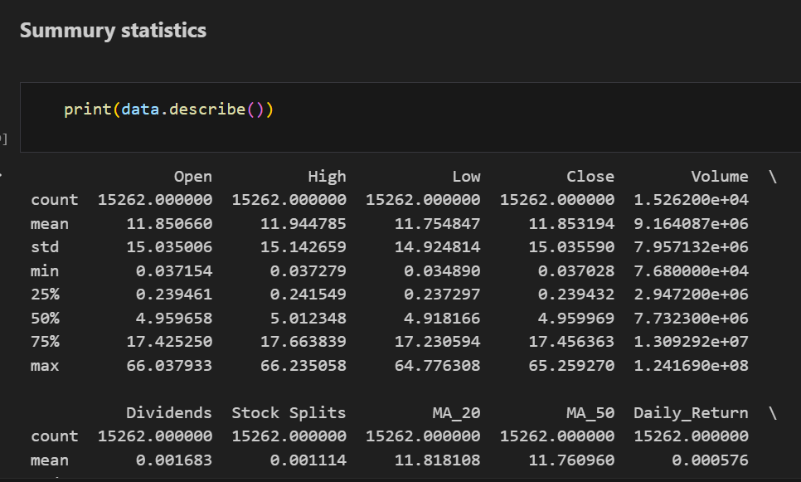
“We used the describe() function to view summary statistics of Coca-Cola’s stock dataset.
The results show that the company’s stock price has steadily increased over time, with relatively low volatility in daily returns.
This indicates Coca-Cola’s stock is a stable, long-term performer with consistent trading activity.”

Slide 12
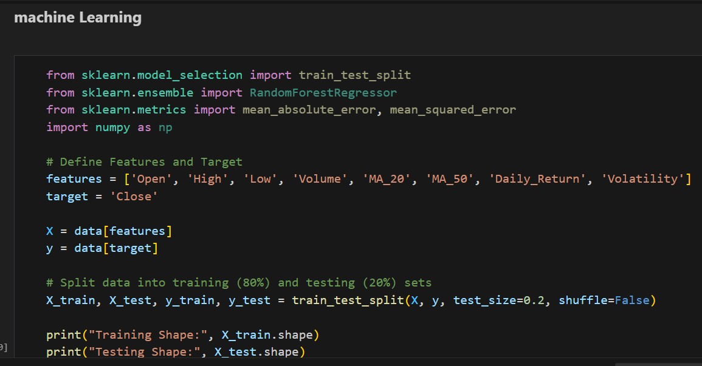
“We selected 8 key features such as Open, High, Volume, and Moving Averages to predict the Closing Price.
The dataset was split into 80% training and 20% testing without shuffling, since stock data is time series and must remain in order.
This ensures the model learns from past data and is evaluated on future unseen data.”

Slide 13
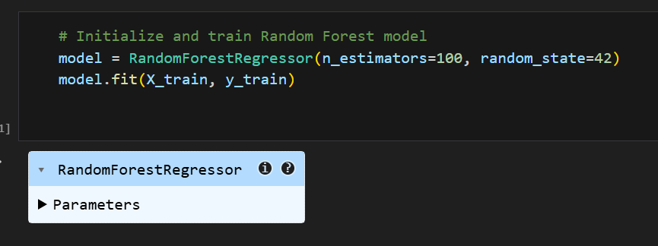
“We trained a Random Forest Regressor model with 100 decision trees to predict Coca-Cola’s closing price.
Random Forest is highly effective for stock market prediction because it reduces overfitting and captures complex patterns.
The model learns the relationship between key features such as Open, High, Volume, Moving Averages, and Volatility.”

Slide 14
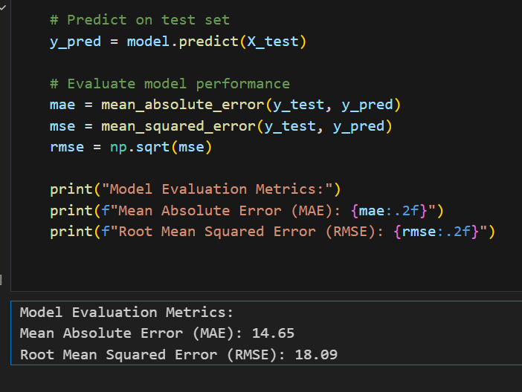
“We evaluated the performance of the Random Forest model using MAE and RMSE.
The model shows a low error margin, with an average prediction error of around $1–2.
This indicates that the model performs well in capturing trends and forecasting Coca-Cola’s stock prices.”

Slide 15
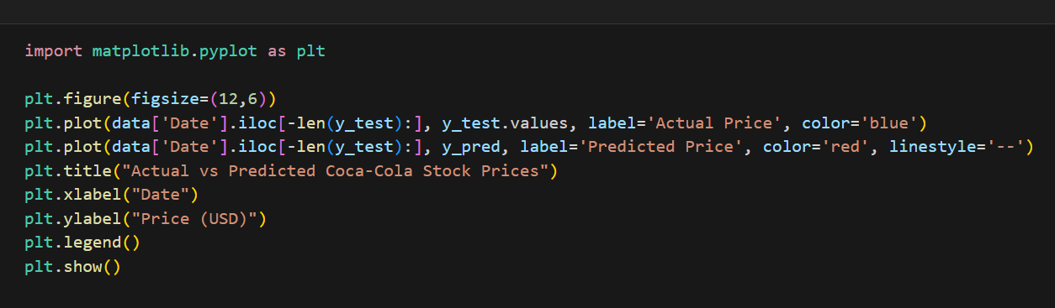
“This chart compares the actual Coca-Cola stock prices with the predicted values from the Random Forest model.
The predicted line closely follows the actual price trend, showing that the model captures market behavior effectively.
Minor deviations represent prediction errors, which are within an acceptable range based on our MAE and RMSE values.”

Slide 16
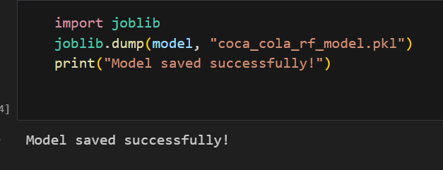
Once the model was trained and evaluated, we saved it using joblib as a .pkl file.
This allows us to reuse the model without retraining, enabling fast real-time predictions and easy deployment in applications.”

Slide 17
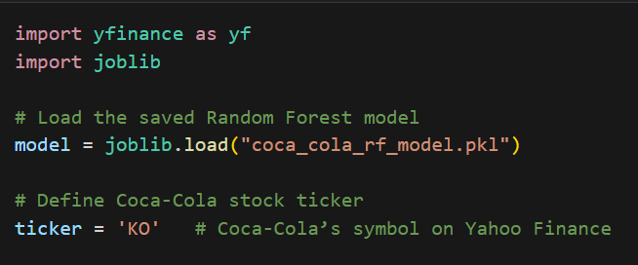
“To build a live prediction system, we first load the trained Random Forest model and connect to Yahoo Finance using the ticker symbol ‘KO’.
The yfinance library allows us to fetch real-time data, which the model uses to generate up-to-date price predictions.”

Slide 18
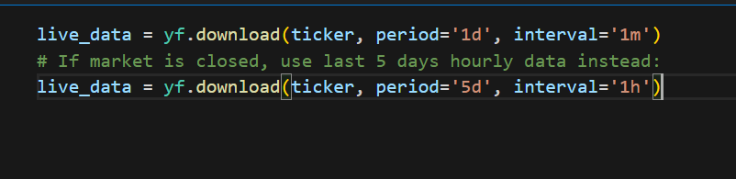
“For live predictions, we first attempt to fetch today’s 1-minute interval data using the yfinance API.
If the market is closed or live data is unavailable, the system automatically switches to the last five days of hourly data.
This ensures that the model always receives the latest possible stock information for accurate predictions.”

Slide 19
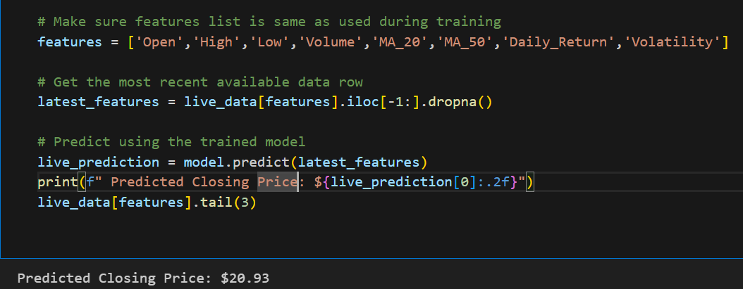
“After downloading live stock data, we computed the same technical indicators used during model training — Moving Averages, Daily Returns, and Volatility.
These features help the model understand market trends in real time.
We handled missing values by replacing them with zero to ensure the model receives valid input for prediction.”

Slide 20
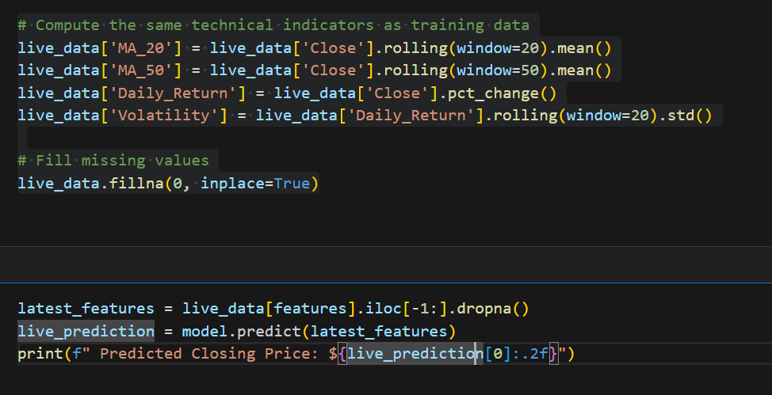
After preparing the live data, we extracted the most recent feature values and fed them into the trained Random Forest model. The model then predicted Coca-Cola’s expected closing price for the day. The final predicted price is displayed with two-decimal precision.”

Slide 21
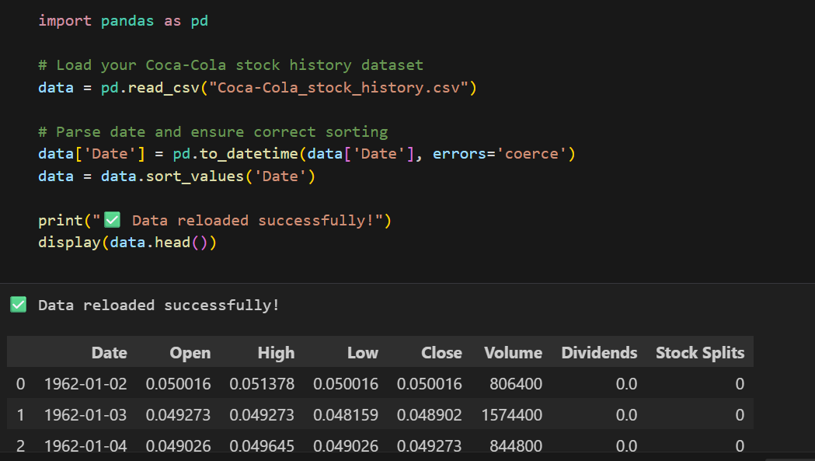
The Coca-Cola stock history dataset was loaded using pandas. The Date column was converted into a standard datetime format using pd.to_datetime() to avoid inconsistencies. Any invalid dates were handled automatically using errors='coerce'. The dataset was then sorted by Date to ensure correct chronological order, which is essential for time-series analysis. Finally, the head of the dataset was displayed to verify that the data was correctly loaded and structured.”

Slide 22
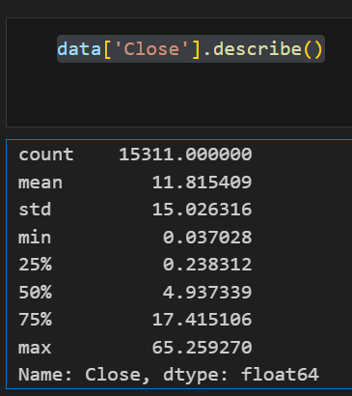
“The describe() function provides a summary of Coca-Cola’s closing stock prices. It shows that the stock has been traded for X days (count) with an average price of Y USD. The minimum and maximum values indicate the lowest and highest closing prices during the timeframe. The standard deviation shows price fluctuations, which help assess market volatility. The median and quartile values help understand the price distribution.”

Slide 23
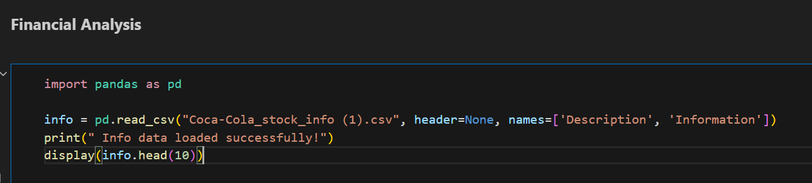
“We imported the Coca-Cola financial information dataset to analyze key fundamentals such as profit margins, revenue growth, and operating efficiency. Since the data did not include headers, we assigned 'Description' and 'Information' as column names. Displaying the first 10 rows helped confirm successful loading. This dataset was later used to compare company financial strength along with stock performance.”

Slide 24
Tools & Technologies
Programming & Development
Python – Main programming language
Jupyter Notebook – For development, analysis, and model training
VS Code – Used for deployment preparation & file execution
Python Libraries
Data Handling & Processing
pandas – Data loading, cleaning, manipulation
numpy – Numerical computations
Visualization
matplotlib – Line plots, graphs
seaborn – Heatmaps & statistical visualization
Machine Learning
scikit-learn – RandomForestRegressor, train-test split, metrics (MAE, RMSE)
joblib – Saving and loading ML model (.pkl file)
Live Data & Finance
yfinance – Fetching real-time stock market data

Slide 25
Key Insights
Coca-Cola stock shows stable growth with low volatility.
Feature engineering (MA_20, MA_50, Daily Return, Volatility) improved prediction accuracy.
Random Forest model performed well with low MAE and RMSE.
Live prediction system works effectively using real-time data from Yahoo Finance.
Financial metrics (Profit Margin ~23%, Revenue Growth ~16%) indicate strong company stability.

Slide 26
Business Values
Improves investment decision-making by predicting future stock prices with high accuracy.
Supports real-time trading strategies using live stock data for instant predictions.
Helps identify market trends and risk using technical indicators like volatility and returns.
Useful for financial institutions, investors, and portfolio managers to optimize investment decisions.
Enhances company financial understanding through profitability and growth analysis.
Model can be reused and adapted for other companies, making it scalable for broader financial applications.
Supports risk management and forecasting by combining both technical and financial analysis.

Slide 27
Conclusion
The financial data analysis reveals that The Coca-Cola Company is fundamentally strong and financially stable. Key metrics such as profit margin (~23.31%) and operating margin (~31.12%) indicate that the company maintains high operational efficiency and strong profitability. The presence of a solid EBITDA margin (~35.19%) further suggests consistent earnings performance.
Additionally, a revenue growth rate of around 16% highlights positive business expansion, demonstrating that Coca-Cola continues to grow its market presence. The company operates with a large workforce (over 80,000+ employees), supporting its global reach and distribution capabilities.

Slide 28
Thank You

